Slide 1
Exploration of Predicting NBA Game Results
Jerel Novick
August 27, 2019

Slide 2
Agenda
Objective
Data
Methodology
Models & Results
Conclusions
Further Development
Questions and Answers

Slide 3
Objective
Build A Model That Can Predict The Outcomes Of NBA Games
(And Maybe Make A Little Money)

Slide 4
Data
Sourced From Kaggle
Basketball Reference
Regular Season Games For The 2012 to 2017 Seasons
14,760 Games
7,380 “Match Ups”
Perfectly Balanced

Slide 5
Methodology
Four Factor Model
Shooting (Field Goals)
Turnovers
Rebounding
Free Throws
Personal Fouls
Game Location
Time Off

Slide 6
Methodology
Training Data – 2012 to 2015 – 9,840 Games
Test Data – 2016 – 2017 – 4,920 Games

Slide 7
First Model – Version One
80.77% Training Accuracy
79.13% Test Accuracy
Coefficients
FGA | FGM | TO | ORB | DRB | FTA | FTM | Location | Days Off | PF
-0.25 | 0.41 | -0.20 | 0.21 | 0.26 | -0.09 | 0.18 | 0.44 | -0.17 | -0.08

Slide 8
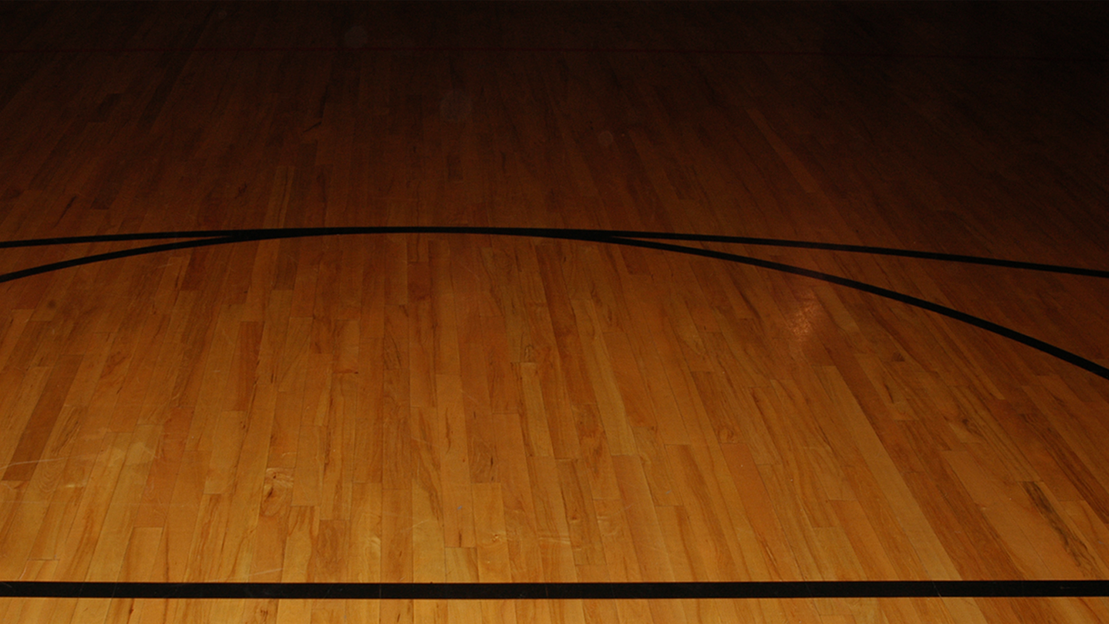
First Model – Version One

Slide 9
First Model – Version Two
Effective Field Goal Percentage
Turnover Percentage
Total Rebound Percentage
Free Throw Percentage
Personal Fouls
Game Location

Slide 10
First Model – Version Two
76.84% Training Accuracy
75.26% Test Accuracy
Coefficients
EFG% | TO% | TREB% | FT% | Location | Days Off | PF
0.20 | -0.18 | 0.16 | 0.02 | 0.50 | 0.004 | -0.08

Slide 11
First Model – Version Two

Slide 12
Second Model – Version One
Five Period Moving Averages
Exclude First Month of the Season
10,800 Games

Slide 13
Second Model – Version One
60.35% Training Accuracy
58.46% Test Accuracy
Coefficients
FGA | FGM | TO | ORB | DRB | FTA | FTM | Location | Days Off | PF
-0.08 | 0.12 | -0.05 | 0.06 | 0.04 | -0.02 | 0.03 | 0.74 | 0.03 | -0.004

Slide 14
Second Model – Version One

Slide 15
Second Model – Version Two
59.85% Training Accuracy
57.89% Test Accuracy
Coefficients
EFG% | TO% | TREB% | FT% | Location | Days Off | PF
0.07 | 0.08 | 0.03 | 0.002 | 0.73 | 0.04 | -0.02

Slide 16
Second Model – Version Two

Slide 17
Conclusion
First Model
Overall Accurate But Loses Predictive Power On Weaker Teams
Backward Looking
Second Model
Moving Averages
Smoothing And Trends Less Predictive
Predicting Favorites?

Slide 18
Further Work
Create And Employ Better Metrics
Look For Interactions
Calculate Win Probabilities
Favorites vs. Dogs?
NCAA
Pythagorean Expectation And Log 5 Models
Look For Value Against Vegas Moneylines
Phone Interview Tomorrow

Slide 19
Questions?

